Slide 1
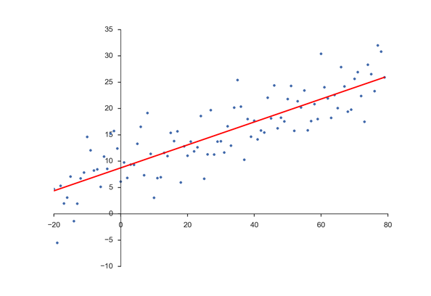
3) Regression Review and Extensions

Slide 2
Regression Analysis
Statistical procedure used to analyze the relationship between a dependent variable Y (also called the response or criterion variable) and one or more explanatory variables (also called independent variables or predictor variables) X1, X2, …, Xk.
Useful for description and prediction.
Demand forecasting
Satisfaction/Loyalty modeling
Product/Service optimization

Slide 3
Regression Analysis
Below are sales volume observations from 16 localities for a line of food products sold in grocery stores. There is interest in predicting sales at a new location.
How might the above information be used to make a prediction?
How can we measure the uncertainty in the prediction?
How might we be able to improve the prediction?

Slide 4
Regression Analysis
Below are sales volume observations from 16 localities for a line of food products sold in grocery stores. There is interest in predicting sales at a new location.
How might the above information be used to make a prediction?
Y = 16.4
How can we measure the uncertainty in the prediction?
Σ(Y_{i} - Y)² = (16.86 – 16.4) ² + (19.99-16.4) ² + … = 85.21 = SST (total sum of squares)
How might we be able to improve the prediction?

Slide 5
Regression Analysis

Slide 6
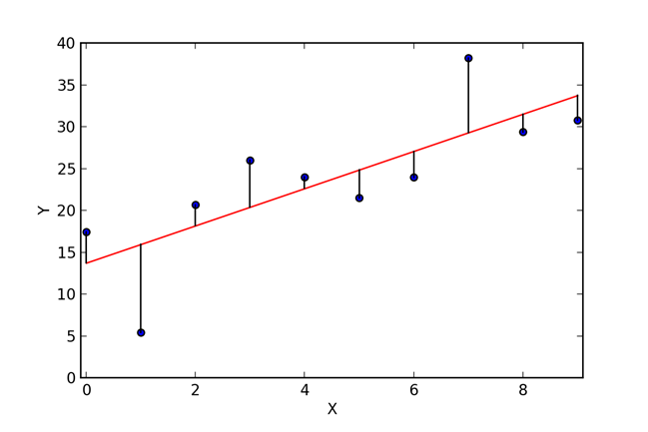

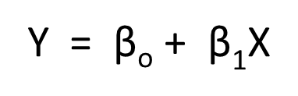
Fitting a line
We want to fit a line to the data for use in prediction and description.
The general equation of the fitted line is:
Deviation or residual
e_{i} = (Y_{i} - Y_{i} )
The method of least squares produces the “best fitting” line to the data in that the sum of squared residuals is minimized. Σe_{i}² = Σ(Y_{i} - Y_{i} )² = Σ(Y_{i} - (B_{o}+B₁X))²
For our data, the equation of the best fitting line is Y = 7.616 + 1.952 X

Slide 7
Regression Analysis
Equation of the best fitting line is
Y = 7.616 + 1.952 X

Slide 8


Fitting a line
For our data, the equation of the best fitting line is Y = 7.616 + 1.952 X
˄
Σ(Y_{i} - Y)²
19.33 = 7.616 + 1.952 (6)
Σ(Y_{i} - Y)²
Note that using the sample mean, the variability measure in sales, SST = 85.21.
Using the regression equation, the remaining variation in sales, SSE = 9.

Slide 9
Regression Analysis
Scatter around mean sales
SST
Scatter around fitted line
SSE
Reduction due to regression relation
= SSR = SST - SSE

Slide 10
Quality of Fit Measurement
We would like to obtain a measure how much we have gained by using the relationship between Adv. (X) and Sales (Y), and the fitted regression line Y
Without incorporating advertising expenditure information we can use the mean of Y for predictions. Uncertainty can be measured with
Σ(Y_{i} - Y)² = SST (total sum of squares) = 85.21
After obtaining the least squares fitted line, we still had some uncertainty remaining (represented by residuals). A measure of this remaining variability is
Σ(Y_{i} - Y_{i} )² = SSE (Sum of squared residuals (errors)) = 9.00
The amount of variation that has been “explained” away by the regression relation is the difference
SST – SSE = SSR (Regression sum of squares) = Σ (Y_{i} - Y)²
85.21 - 9.00 = 76.21
Rearranging:
SST = SSR + SSE (called Analysis of Variance, ANOVA)
Total Explained Unexplained
Variation Variation Variation
85.21 = 76.21 + 9.00
And the proportionate reduction in total variation = SSR/SST = 76.21/85.21 = .89
SSR/SST is called the coefficient of determination and denoted r²
^
^

Slide 11
Quality of fit measurement, Summarizing
Putting it together,
SST = SSR + SSE
Called analysis of variance (ANOVA)
Coefficient of determination
r² = SSR/SST (relative reduction in variation of Y)
Correlation coefficient
r = (+/-) r² (sign determined by sign of slope β₁)
For our example, r2 = .89, sqrt(.89) = .94,
r = .94 (positive since our slope is positive, Y = 7.616 + 1.952 X)
^
^

Slide 12

Regression Analysis
Conceptual Model for simple linear regression
Y = β_{o} + β₁X + ε
Where the errors are assumed independent, normal, with mean 0 and constant variance
Note that from our sample we obtain: Y = β_{o} + β₁X
β₁ is a point estimator of β₁
β_{o} is a point estimator of β_{o}
Y is a point estimator of β_{o} + β₁X = μ
(and also a point estimator of a predicted Y value)
^
^
^
^

Slide 13
Test of a relationship
Ho: β₁=0
H_{1:} β₁ not 0
Decision rule: H₁ if P-value < α, else Ho
Where the test statistic is t= β₁ /SE(β₁)
^
^

Slide 14
Regression Analysis
Software output for our simple linear regression example
Analysis of Variance (ANOVA)
Sum of
Squares
Regression 76.20608
Residual 9.00452
Total 85.21060
R-Square 0.8943
Probability value (p-value) to test if AdExp should be dropped from model (if sample evidence indicates corresponding Beta =0 or not). Typical rule, if p-value < .05, conclude corresponding Beta is not 0)
Confidence limits provide information about the precision of the estimate
B₁ +/- t *SE(B₁)
^
^

Slide 15
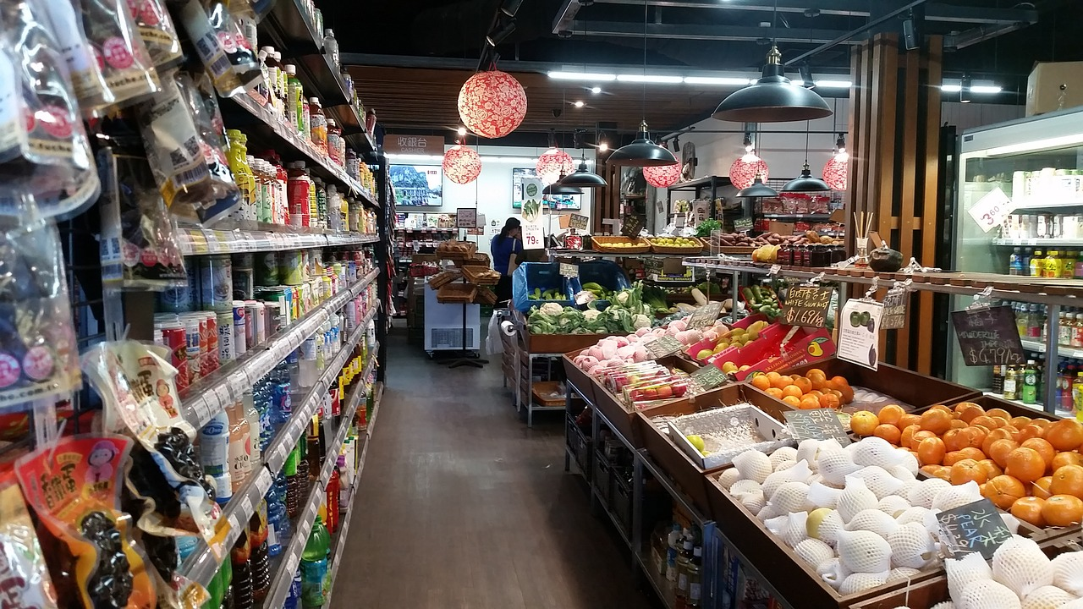
Regression Analysis
Multiple Regression
Multiple regression conceptual model
Y = β_{o} + β₁X₁ + β₂X₂ + … + β_{k}X_{k} + ε
Y = β_{o} + β₁X₁ + β₂X₂ + ε
Extending our example by including a second explanatory variable: point-of-sale expenditure (X₂)

Slide 16
Test for relation involves an F test
Y = β_{o} + β₁X₁ + β₂X₂ + ε
H_{o}: β₁ = β₂ =0
Η₁: not all above equalities hold
DR: H₁ if P-value < α, else Ho.
Test Statistic F = (SSR/k)/(SSE/(n-k-1))
Recall Analysis of Variance (ANOVA)
SST = SSR + SSE
Total Explained Unexplained
Variation Variation Variation

Slide 17
^
Sales = 5.245 + 1.952 AdExp + 0.527 POSExp

Slide 18
Multiple Regression
The same concepts of parameter estimation (least squares) and Analysis of Variance (SST=SSR + SSE, r² = SSR/SST) from simple linear regression extend to multiple regression.
Comparing the results of the two models (estimated standard errors in parentheses)
Sales = 7.616 + 1.952 AdExp r² = .89
(0.179)
Sales = 5.245 + 1.952 AdExp + 0.527 POSExp r² = .96
(0.115) (0.115)
^
^

Slide 19
Regression Analysis
Example: A multiple regression was performed relating sales with TV and Radio advertising expenditure.
Sales = 57.3 + 9.2 TV + 3.3 Radio
A regression using only Radio advertising expenditure as a predictor produced the following
Sales = 77.8 + 8.2 Radio
Comments on the differences in the coefficients for radio advertising expenditure?
^
Correlations
^

Slide 20
Regression Analysis
Comments on omitted variables
Impact on precision of estimates
Bias in coefficient estimates (correlated variables)

Slide 21
Regression Analysis
Standardized Regression Coefficients
Standardized coefficients, or beta weights as they are sometimes called, are sometimes used in practice to indicate relative importance of predictor variables.
They can be obtained by performing the regression on the standardized form of the variables. Returning to our example:
Z= (x – Mean)/Std.Dev

Slide 22
Regression Analysis
Standardized Regression Coefficients
Regression results
SSales = 0.946 SAdExp + 0.255 SPOSExp r² = .960
Recall the correlation matrix. Note some interesting relationships!
^

Slide 23
Regression Analysis
Standardized Regression Coefficients (Beta Coeff.): Comments
-Measure relative explanatory power of predictors
-When predictors are uncorrelated
Beta coefficients = correlation coefficients
The sum of the squared Beta coeffs (corr coeffs.) = multiple r²
Note: .946² + .255² = .895 + .065 = .96
(Adv.) (POS) (Adv.) (POS)

Slide 24
Estimating the Mean Y Value and Predicting an Individual Y Value (Forecasting)
For our grocery store sales example, what would you estimate average sales to be if $4,500 is spent on Advertising and $5,500 on POS?
Recall our estimated regression equation
Sales = 5.245 + 1.952 AdExp + 0.527 POSExp
What would you predict sales to be next period at a location that spends $4,500 on advertising and $5,500 on POS?
^

Slide 25
Estimating the Mean Y Value and Predicting an Individual Y Value (Forecasting)
^
Y provides point estimates of both the mean value of Y and a predicted individual Y value.
As a point estimate, we don’t obtain information about precision. Confidence intervals/limits provide information about precision.
Statistical software packages (e.g., SPSS) will provide these interval estimates if requested.
For our grocery sales example, the 95% interval estimate for mean sales with AdExp=$4,500 POSExp= $5,500 is
(16.55, 17.30) Y +/- t*SE(mean)
The 95% prediction interval with AdExp=$4,500 POSExp= $5,500 is
(15.75, 18.10) Y +/- t*SE(prediction)
Interpretation? Is it reasonable that the prediction interval is wider?
^
^

Slide 26
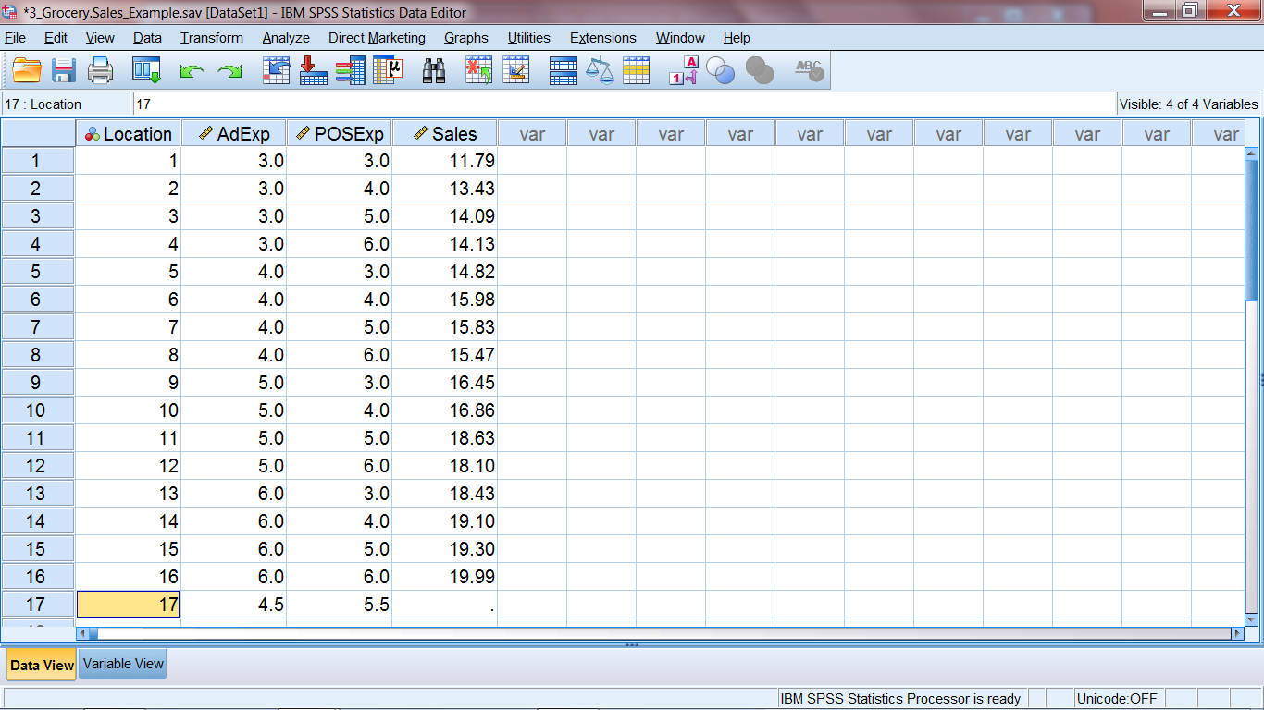
SPSS screen shots for class example (SPSS file “GrocerySales_Example.sav”)
Open the file and type in the values in row 17 for SPSS to produce prediction for sales for the specified AdExp and POS Exp values

Slide 27
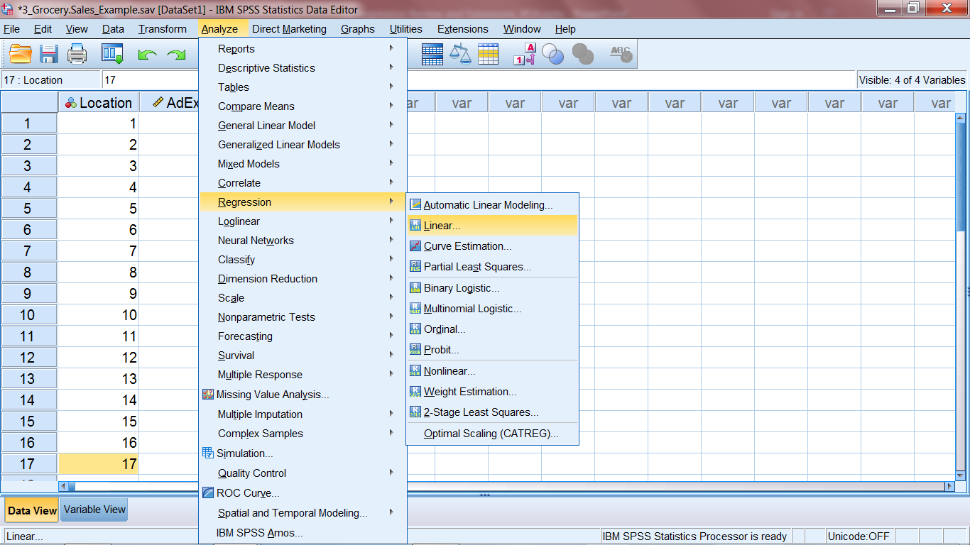

Slide 28
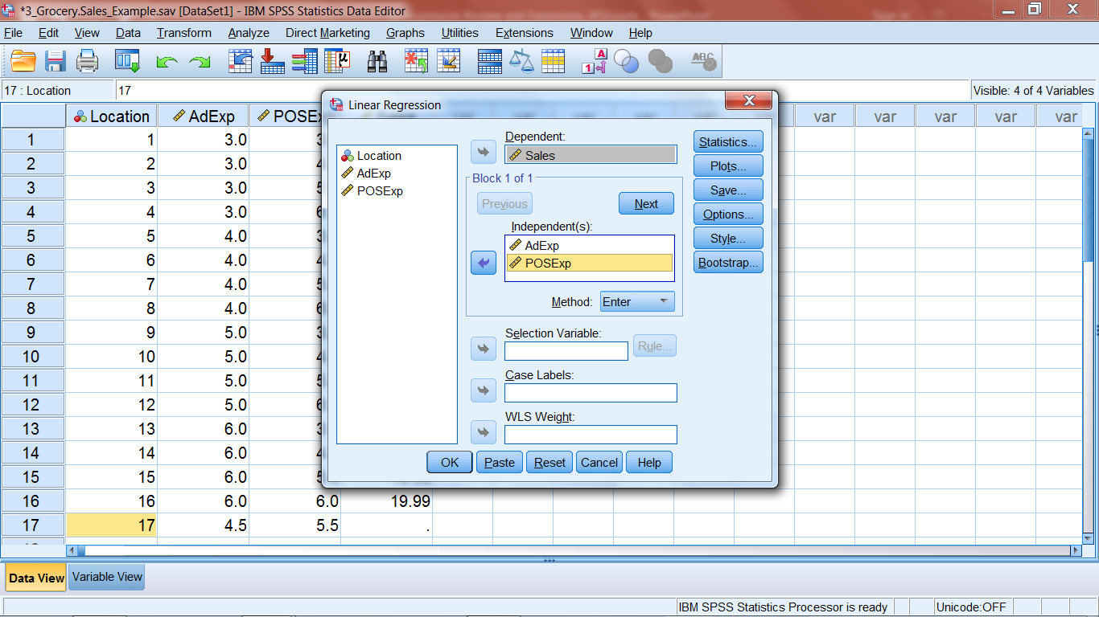



Slide 29
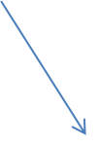
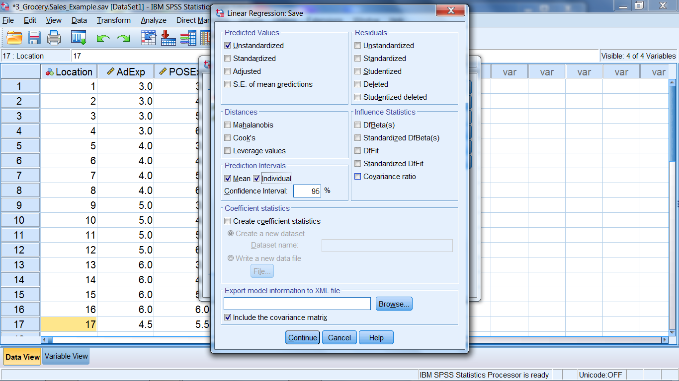


Slide 30
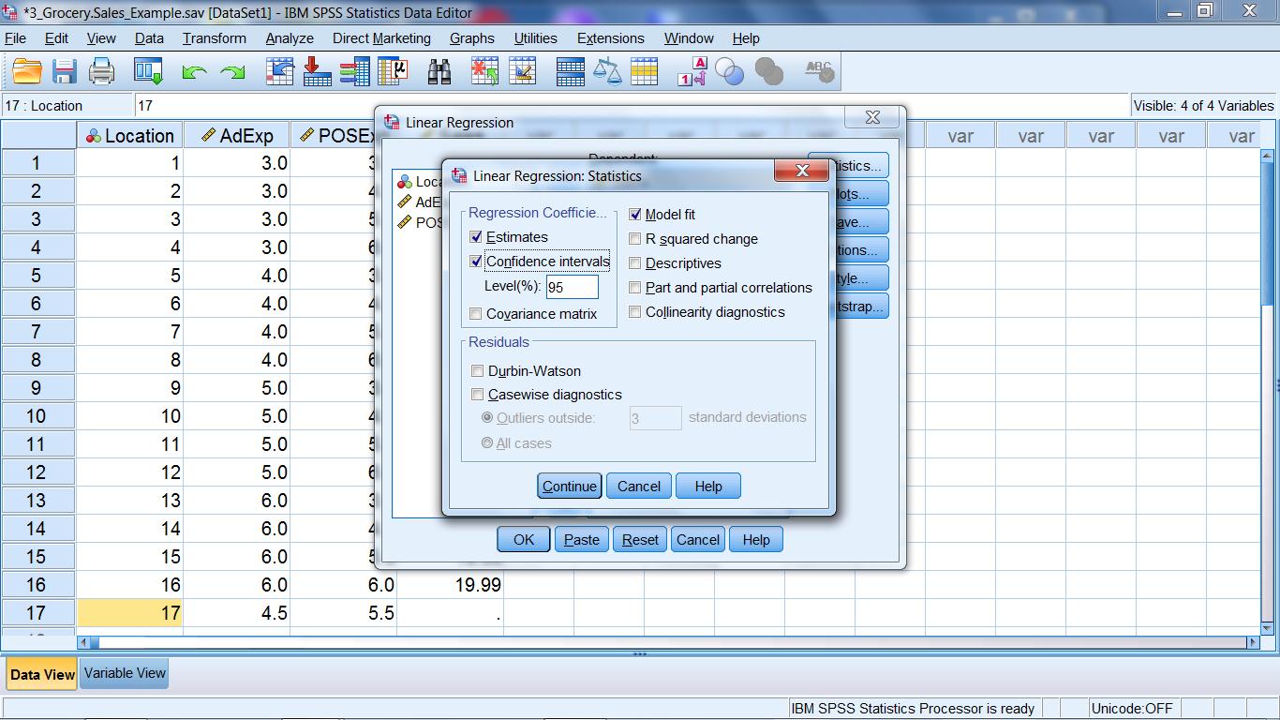

Slide 31
^
Sales = 5.245 + 1.952 AdExp + 0.527 POSExp

Slide 32




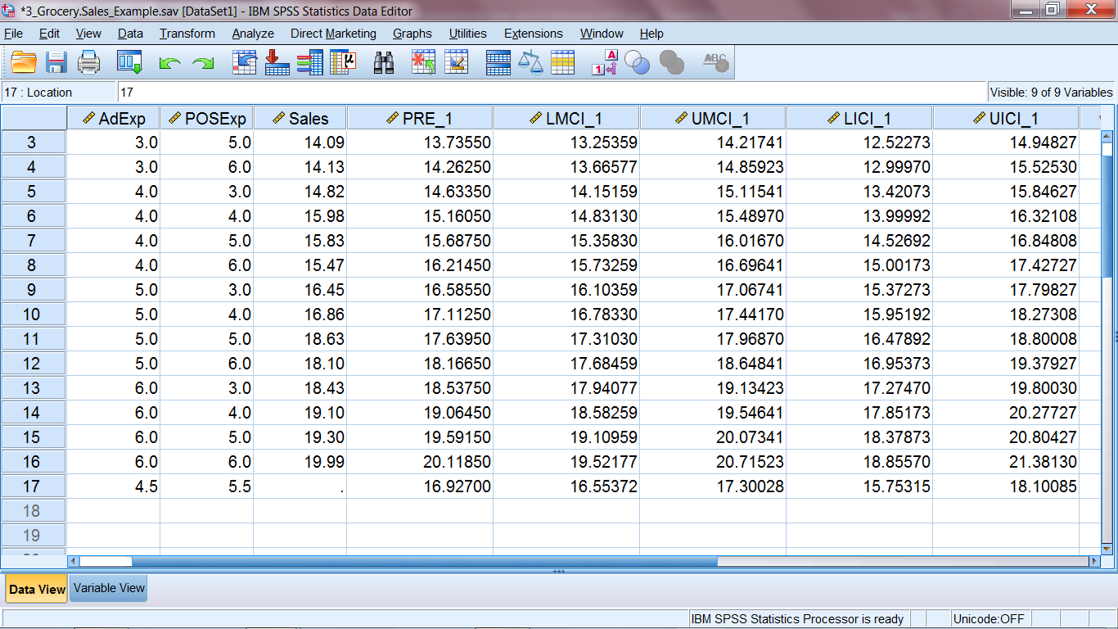
Prediction limits for individual Y
^
Y
CI for mean of Y
Yhat = 5.245 + 1.952 (4.5) + .527 (5.5)

Slide 33
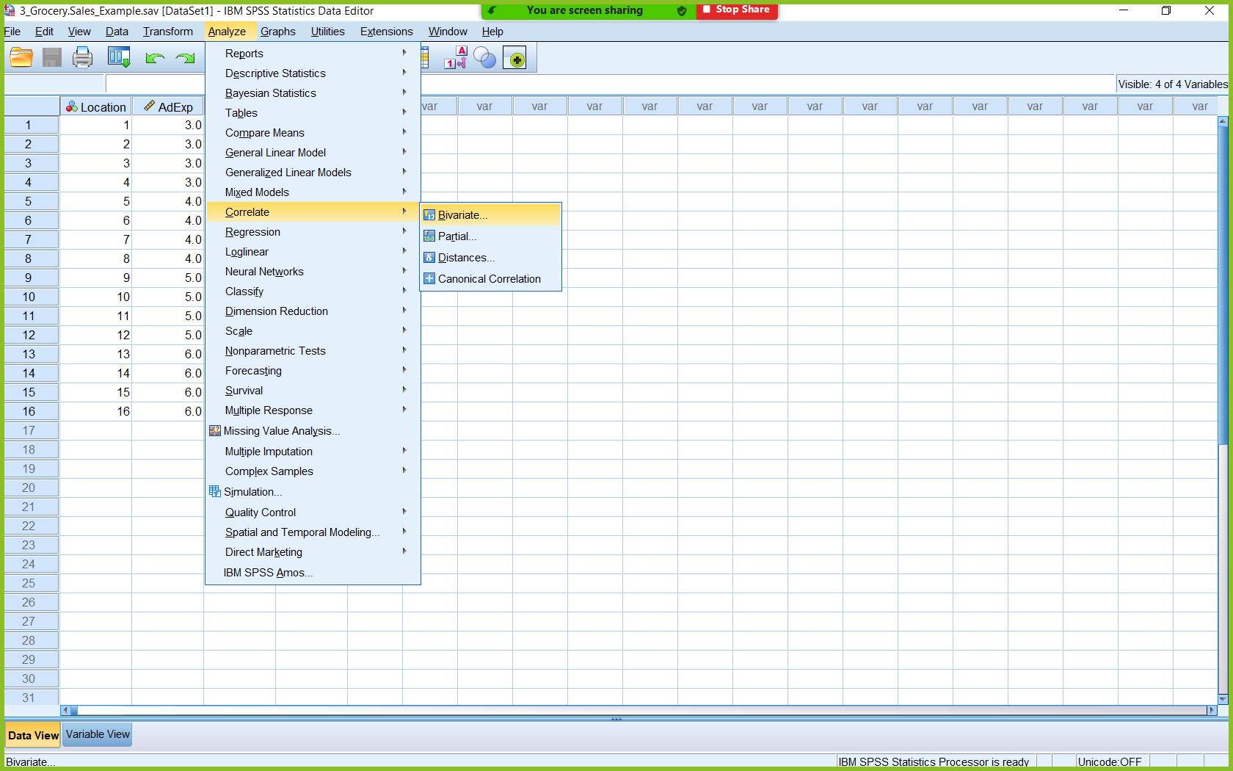
To obtain table of bivariate correlations

Slide 34
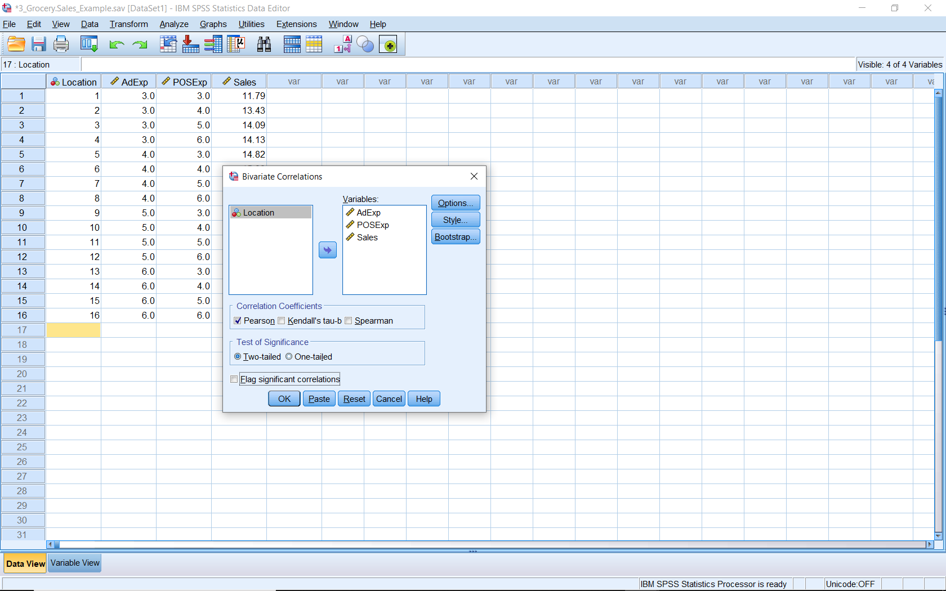
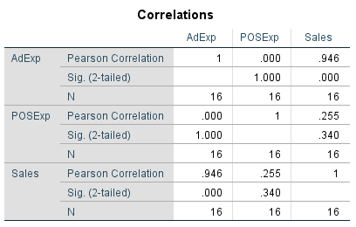
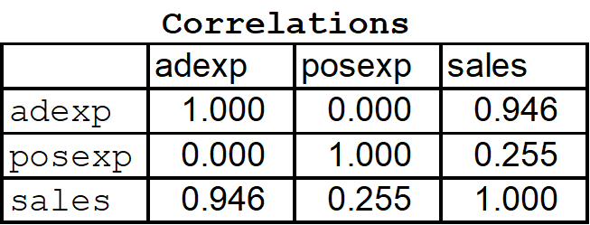

Slide 35
Added Application 1) There is interest in understanding home valuation based on the square footage and age of the home. SPSS file HouseValue.sav has information on a sample of 80 homes regarding valuation (in $, variable “Value”), age (in years, variable “Age”) and size (in square feet, variable “SqFt”). The client is interested in the impact of each variable on home value, and in making valuation forecasts.
Obtain the estimated/fitted regression equation and evaluate the quality of fit.
Determine if there is a significant relationship between house value and the age and size of the house.
Can either Age or SqFt be dropped from the model?
What are the estimated contributions of Age and SqFt?
What would you forecast value to be for a home that is 27 years old and 1800 sq.ft.?
Another analyst estimated a simple model that only included Age and is wondering why their estimate of the impact of Age on value is different from yours (where you included both Age and SqFt.) How would you respond?

Slide 36
SAS Code for Class Examples
Grocery Sales Example
data gse;
input location AdExp POSExp Sales;
datalines;
1 3.0 3.0 11.79
2 3.0 4.0 13.43
3 3.0 5.0 14.09
4 3.0 6.0 14.13
5 4.0 3.0 14.82
6 4.0 4.0 15.98
7 4.0 5.0 15.83
8 4.0 6.0 15.47
9 5.0 3.0 16.45
10 5.0 4.0 16.86
11 5.0 5.0 18.63
12 5.0 6.0 18.10
13 6.0 3.0 18.43
14 6.0 4.0 19.10
15 6.0 5.0 19.30
16 6.0 6.0 19.99
17 4.5 5.5 .
;
run; *obtaining predicted value for AdExp= 4.5, POSExp=5.5 for location 17;
Title "Simple Linear Regression: Grocery Example";
proc reg data=gse;
model sales=AdExp;
run;
Title "Multiple Regression: Grocery Example";
proc reg data=gse;
model sales=AdExp POSExp/clb stb;* clb requests conf. limits for coeff. stb requests the
standardized coefficients;
output out=results p=yhat LCLM=LLMean UCLM=ULMean LCL=LLPred UCL=ULPred ;
run;
*Creating file "results" saving yhat values (in variable yhat), upper and lower confidence
limits for the mean of y (in variables ULMean, LLMean) and upper and lower prediction
limits (in variables ULPred, LLPred);
proc print data=results;run;

Slide 37
Grocery Sales Example (Continued)
proc corr data=gse;
where location <=16;
var sales AdExp POSExp;run;
*obtaining correlation matrix (not including location 17 for the prediction);

